Slide 1
Sorting and Tree
075BCT009 Adithya Pokharel
075BCT010 Aakash Panthi
075Bct022 Bipin Khanal

Slide 2
openFramework
openFramework is an open source toolkit designed for creative coding(create something expressive such as visuals instead of something functional).
openFramework is written in C++ and built on top of OpenGL.

Slide 3
Sorting
Sorting refers to arranging data in a particular format.
Sorting algorithm specifies the way to arrange data in a particular order.
Some Sorting Algorithms
Bubble Sort
Selection Sort
Insertion Sort
Merge Sort

Slide 4
Bubble Sort
Bubble Sort is the simplest sorting algorithm that works by repeatedly swapping the adjacent elements if they are in wrong order.
Time complexity
Best Complexity :O(n)
Average Complexity :O(n^2)
Worst :O(n^2)

Slide 5
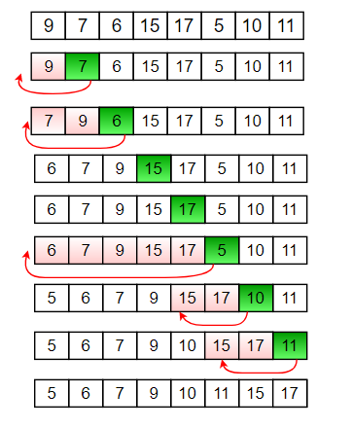
Insertion Sort
The array is virtually split into a sorted and an unsorted part. Values from the unsorted part are picked and placed at the correct position in the sorted part.
Time Complexity
Best Case: O(n)
Average :O(n^2)
Worst Case: O(n^2)

Slide 6
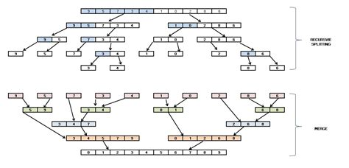
Merge Sort
Merge sort algorithm uses the “divide and conquer” strategy where we divide the problem into sub problems and solve those sub problems individually
Time Complexity
Best Case: O(n log n)
Average Case(n log n)
Worst Case: O(n log n)

Slide 7
Binary Search Tree
Binary Search Tree is a node-based binary tree data structure which has the following properties:
The left sub tree of a node contains only nodes with keys lesser than the node’s key.
The right sub tree of a node contains only nodes with keys greater than the node’s key.
The left and right sub tree each must also be a binary search tree.

Slide 8
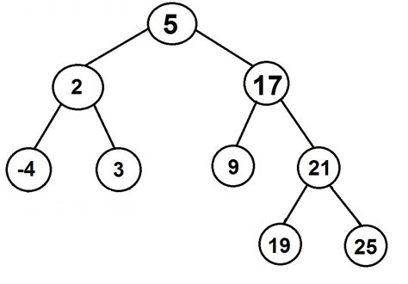

Slide 9
Demo

